Slide 1
Final Report
Group 7
La Ngoc Anh – 20521065
Truong Thi Hoang Hao – 20520191
Truong Dinh Trong Thanh – 20520766
Tran Thuy Anh – 20521085
23/12/2023

Slide 2

About Project
Focus on system / network / security design for payment platform like PayPal.
2

Slide 3
Table of content
Performance
High Availability
Scale
Security
P
H
Overview of the system performance
The ability of a system, component, or application to operate continuously without failing for a designated period of time
S
S
Horizontal Scaling
Different security method
O
Operation
System operation and workflow
3

Slide 4
Table of contents
01.
Performance:
User need
Traffic handling
4

Slide 5
Table of contents
02.
High Availability
Auto-scaling group
AWS RDS (master and slave “syn and replication”)
Application load balancer
Route 53
Data caching
5

Slide 6
Table of contents
03.
Scale
Microservice Kubernetes on AWS EKS
Horizontal scale different availability zones
VPC Peering and Route 53 for domain backup
Cloud Front
6

Slide 7
Table of contents
04.
Security
WEB application firewall
Sand Box, Honey bot, Endpoint gateway, Database Firewall, AWS RDS (Data encryption – data in transfer/store/use)
VPC (Virtual Private Cloud)
Monitor and logging
Security and compliance , SIEM/SOAR
Secure VPN, Single sign on, IAM, Access list
Direct connect
Micro-segmentation security for Kubernetic service
Private Link
7

Slide 8
Table of contents
05.
Operation
Kubernetes microservice on AWS EKS
EC2 web/app service
8

Slide 9
End-user requirement
 | Business | Technical
USER | Up to 100.000 users account to storage Min 5.000 accounts | Database (500GB), support scaling, high availability Sensitive data must ne encrypted
CONNECTION per SEC | Peak: 25.000 users Normal: 5.000 – 20.000 users | Reduce latency, traffic volumes, …
DEVICE | Mobile app, web browser
9

Slide 10
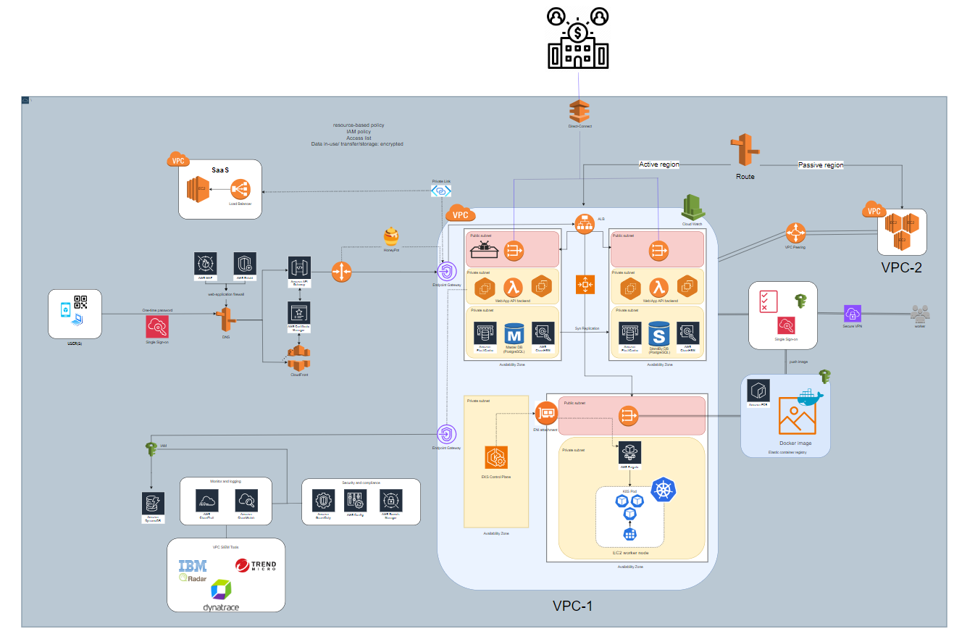
System overview
10

Slide 11
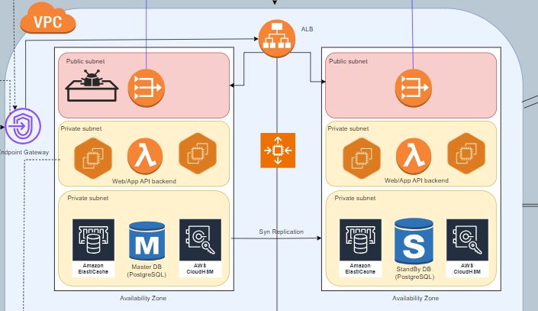
Core system
11

Slide 12
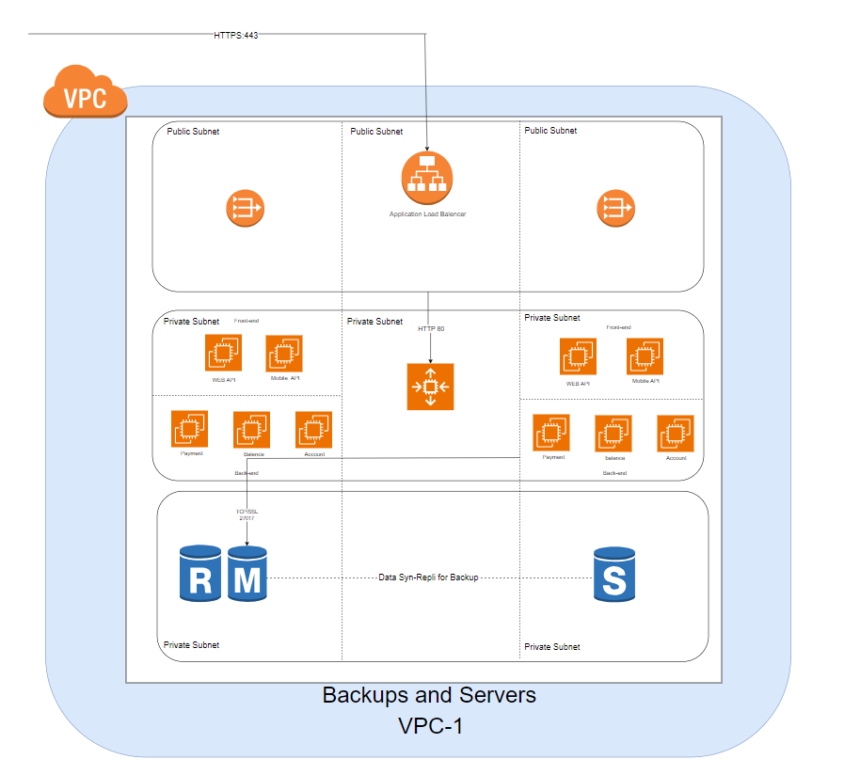
Core system
12

Slide 13
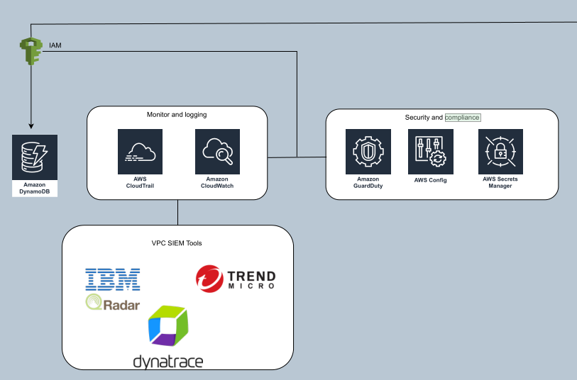
Monitor
13

Slide 14
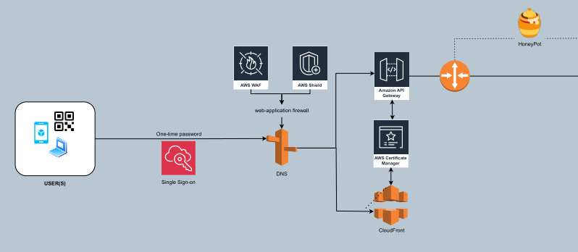
System
14

Slide 15
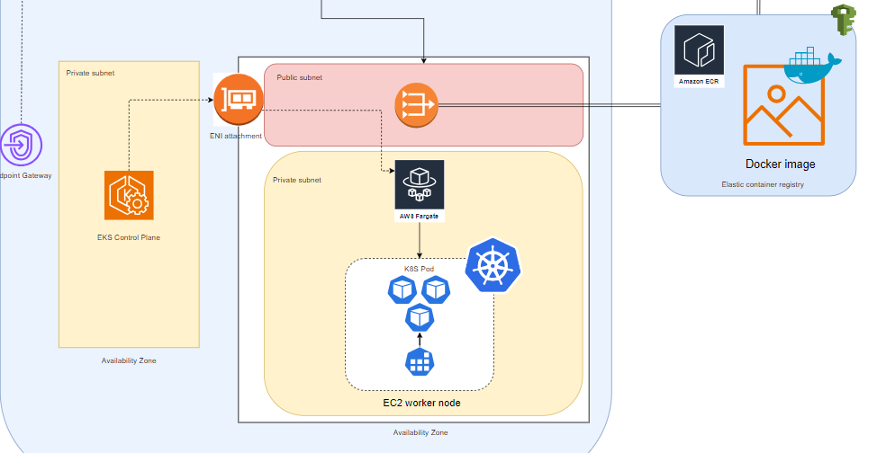
AWS EKS – Kubernetes microservice
15

Slide 16

Thanks!
Do you have any questions?
20521065@gm.uit.edu.vn
Please keep this slide for attribution
16

